Slide 1
Certification Automation using n8n

Slide 2
Abstract
Automates generation and emailing of digital certificates
Built using n8n, a low-code automation platform
Integrates Google Sheets, Drive, and Gmail
manual work, errors, and increases efficiency

Slide 3
Problem & Objectives
Problem:
Manual certificate creation is time-consuming
Human errors during name entry, file management, and email sending
Objectives:
Automate certificate creation and emailing
Integrate Google Workspace APIs efficiently
Ensure scalability and reusability for multiple events

Slide 4
System Architecture

Slide 5
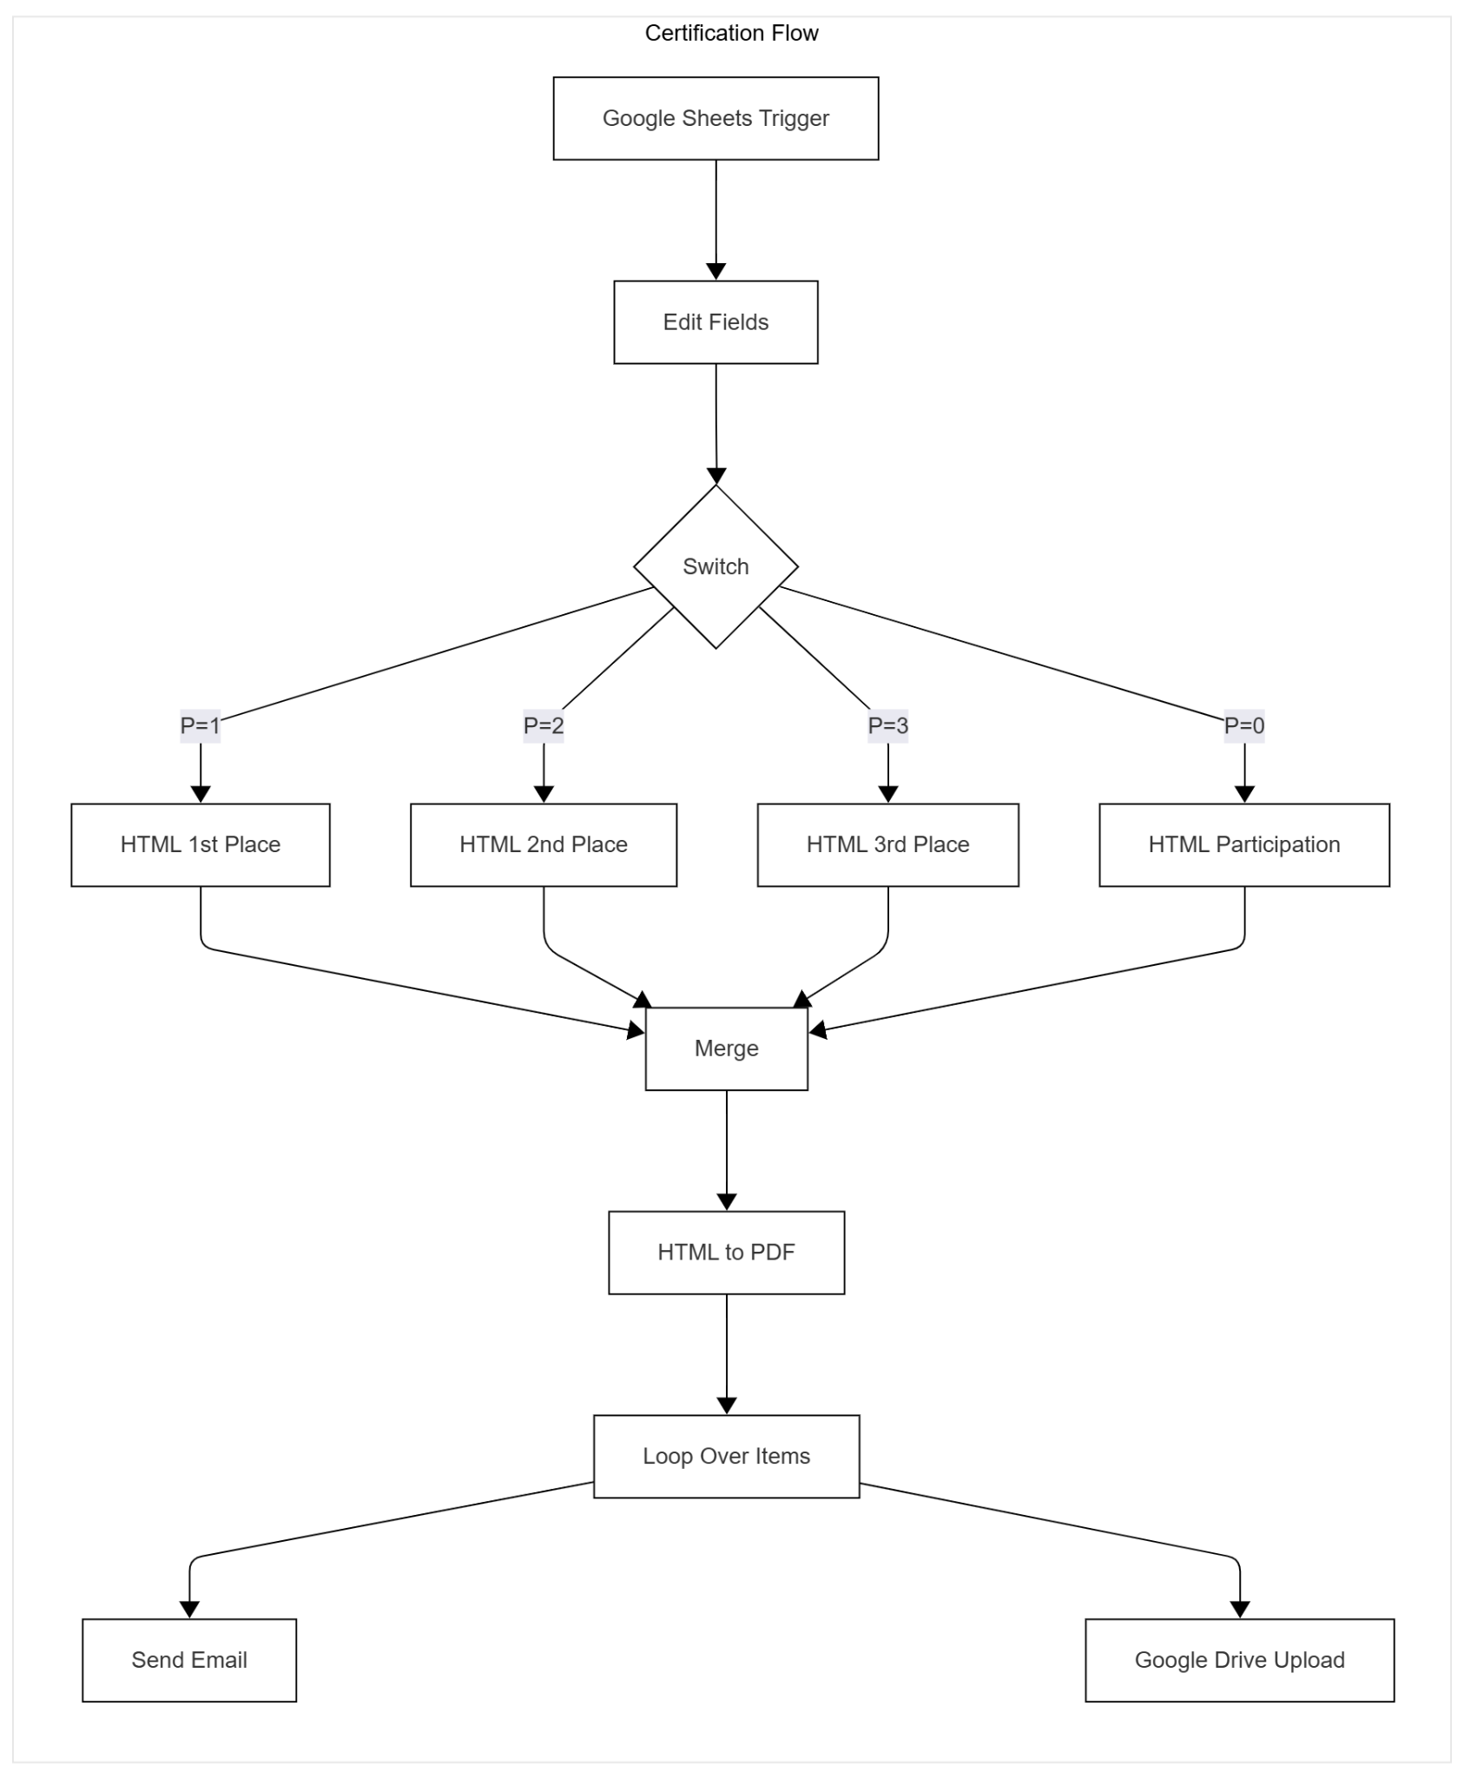

Slide 6
Components in the Workflow
Type | Tool / Node | AI-Agent Function
Workflow Orchestrator | n8n | Main automation agent
Decision Making | Switch Node | Rule-based logic agent
Data Handling | Set / Merge Nodes | Data-processing agent
Content Generation | HTML Template + PDF Node | Generative automation
External Integration | Google APIs | Action & communication agents

Slide 7
Integrations & Output

Slide 8
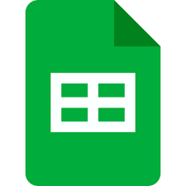

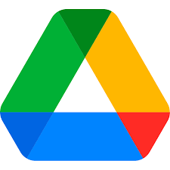
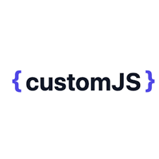
Integrations Used:
Google Sheets API
Gmail API
Google Drive API
Custom JS API

Slide 9
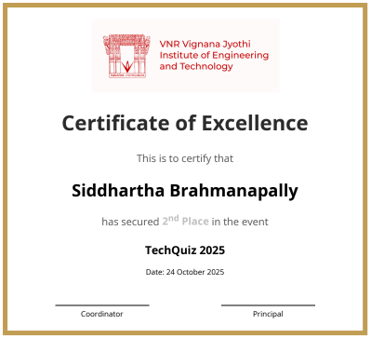
Output
Personalized certificate (PDF)

Slide 10
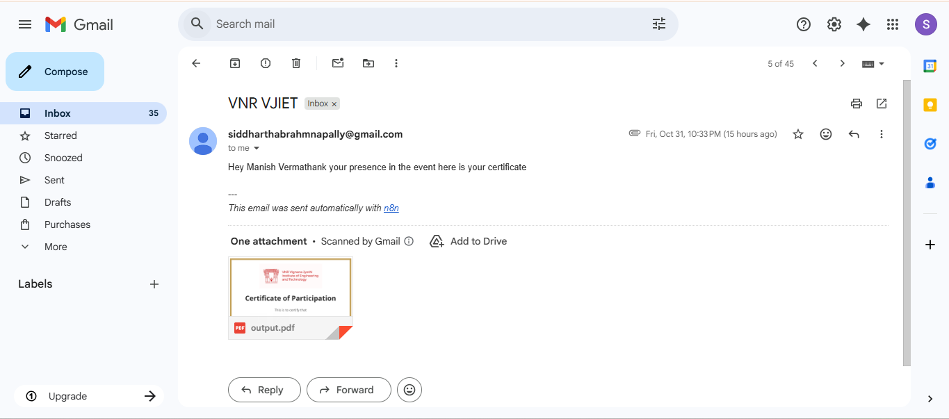
Auto email with attachment

Slide 11
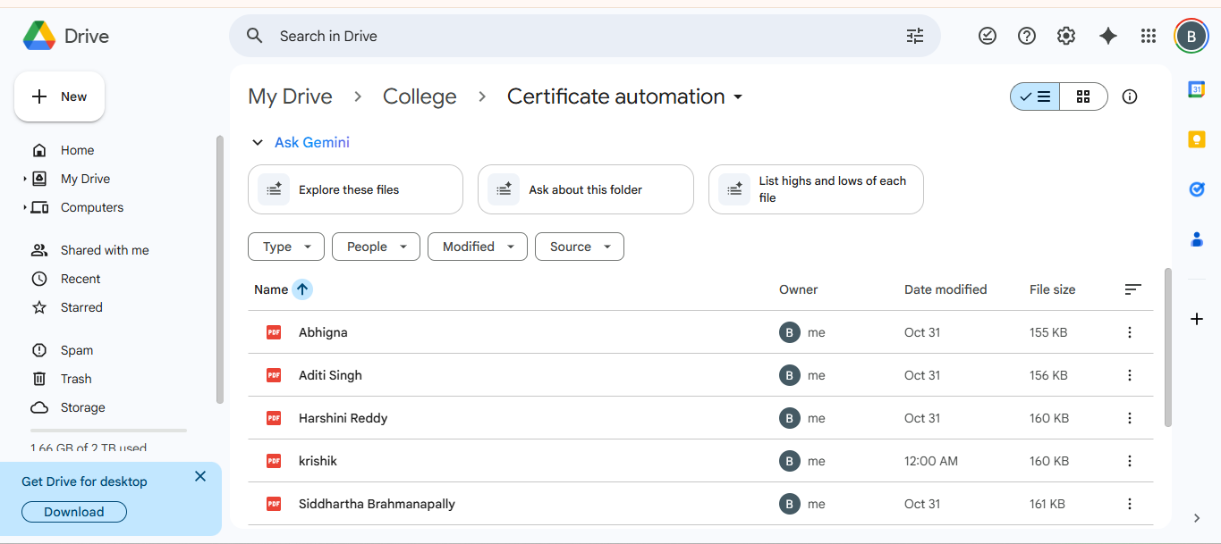
Copy saved in Drive

Slide 12
Results & Benefits
Saves administrative time
Zero manual errors
Reusable workflow
Easy scaling for multiple events

Slide 13
Future Scope
Add QR-based certificate verification
Planning to make as a Bot in telegram so that everyone could access easily

Slide 14
Thanks!

